Slide 1

AWS
CLOUD GUARD

Slide 2

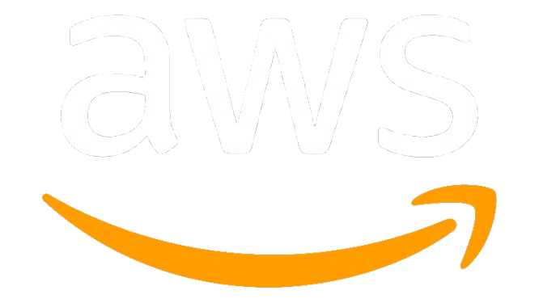
Agenda
Motivation
Problem statement
Objective
Architecture diagram
Outcome of the project
Screengrab's of the project
Conclusion

Slide 3
MOTIVATION
Addressing Cloud Security Gaps: Ensures AWS resources like S3 buckets and EC2 instances are securely configured, preventing common misconfigurations that lead to vulnerabilities.
Automated Security Auditing: Simplifies and automates the scanning and identification of security issues in AWS environments, saving time and reducing human error.
Compliance with Global Standards: Helps organizations adhere to important regulatory frameworks such as GDPR, NIST, and PCI DSS, ensuring they meet industry standards for security and privacy.
Real-Time Mitigation: Provides immediate remediation for security issues, enabling organizations to fix misconfigurations quickly and effectively without manual intervention.
Building Trust and Credibility: Enhances the organization's reputation by demonstrating a commitment to security and compliance, building trust with customers and stakeholders.

Slide 4
Problem statement
Increased Vulnerability to Misconfigurations: Cloud environments, particularly AWS, are prone to misconfigurations that can lead to security breaches, such as open S3 buckets or unsecured EC2 instances.
Manual Security Audits Are Time-Consuming: Manually auditing AWS resources for security vulnerabilities is a complex, error-prone, and time-consuming task, requiring specialized knowledge and constant attention.
Lack of Automated Remediation: While security issues can be identified, the absence of automated remediation tools results in delays in addressing critical vulnerabilities, increasing the risk of exploitation.
Difficulty in Ensuring Compliance: Organizations struggle to maintain compliance with regulatory frameworks like GDPR, NIST, and PCI DSS without comprehensive and automated tools that ensure continuous adherence.
Cloud Security Complexity for Non-Experts: Many organizations, especially smaller ones, lack the expertise to implement and maintain cloud security best practices, leaving them vulnerable to emerging threats and attacks.

Slide 5
OBJECTIVE
Automated Cloud Security Assessment: To provide an automated solution that scans AWS resources like EC2 instances and S3 buckets for misconfigurations and security vulnerabilities, ensuring that critical assets are secured without the need for manual checks.
Compliance with Industry Standards: To ensure that cloud resources are compliant with global security standards such as GDPR, NIST, and PCI DSS, providing businesses with an easy way to meet regulatory requirements.
Real-time Vulnerability Detection and Mitigation: To detect security issues in real-time and offer mitigation suggestions and automated fixes for vulnerabilities like open ports, lack of encryption, and insecure access controls.
Enhanced User Experience and Reporting: To deliver a user-friendly interface where users can easily scan resources, receive comprehensive security reports, and download actionable insights, improving the overall security posture of the organization.

Slide 6
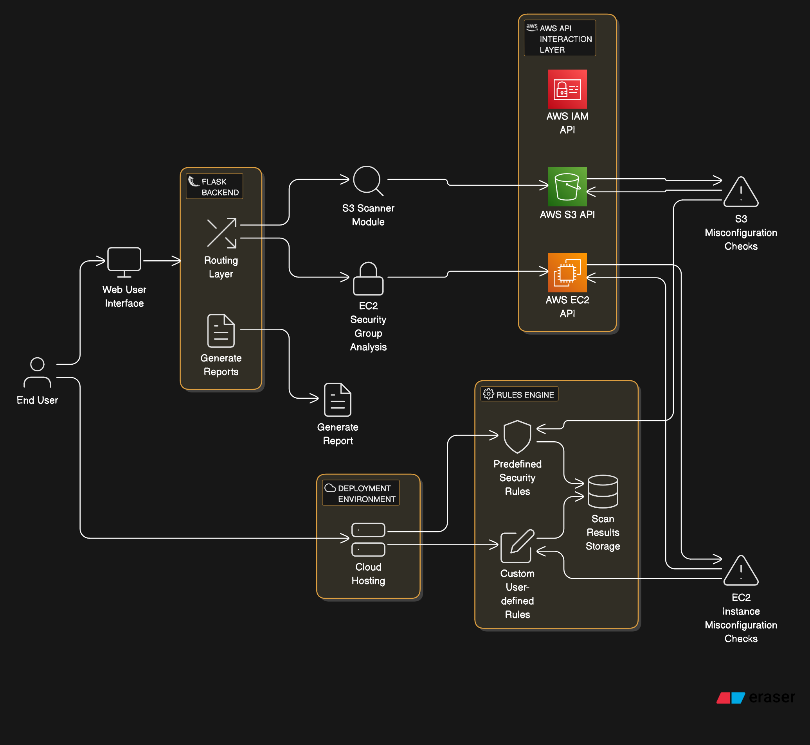
ARCHITECTURE DIAGRAM

Slide 7
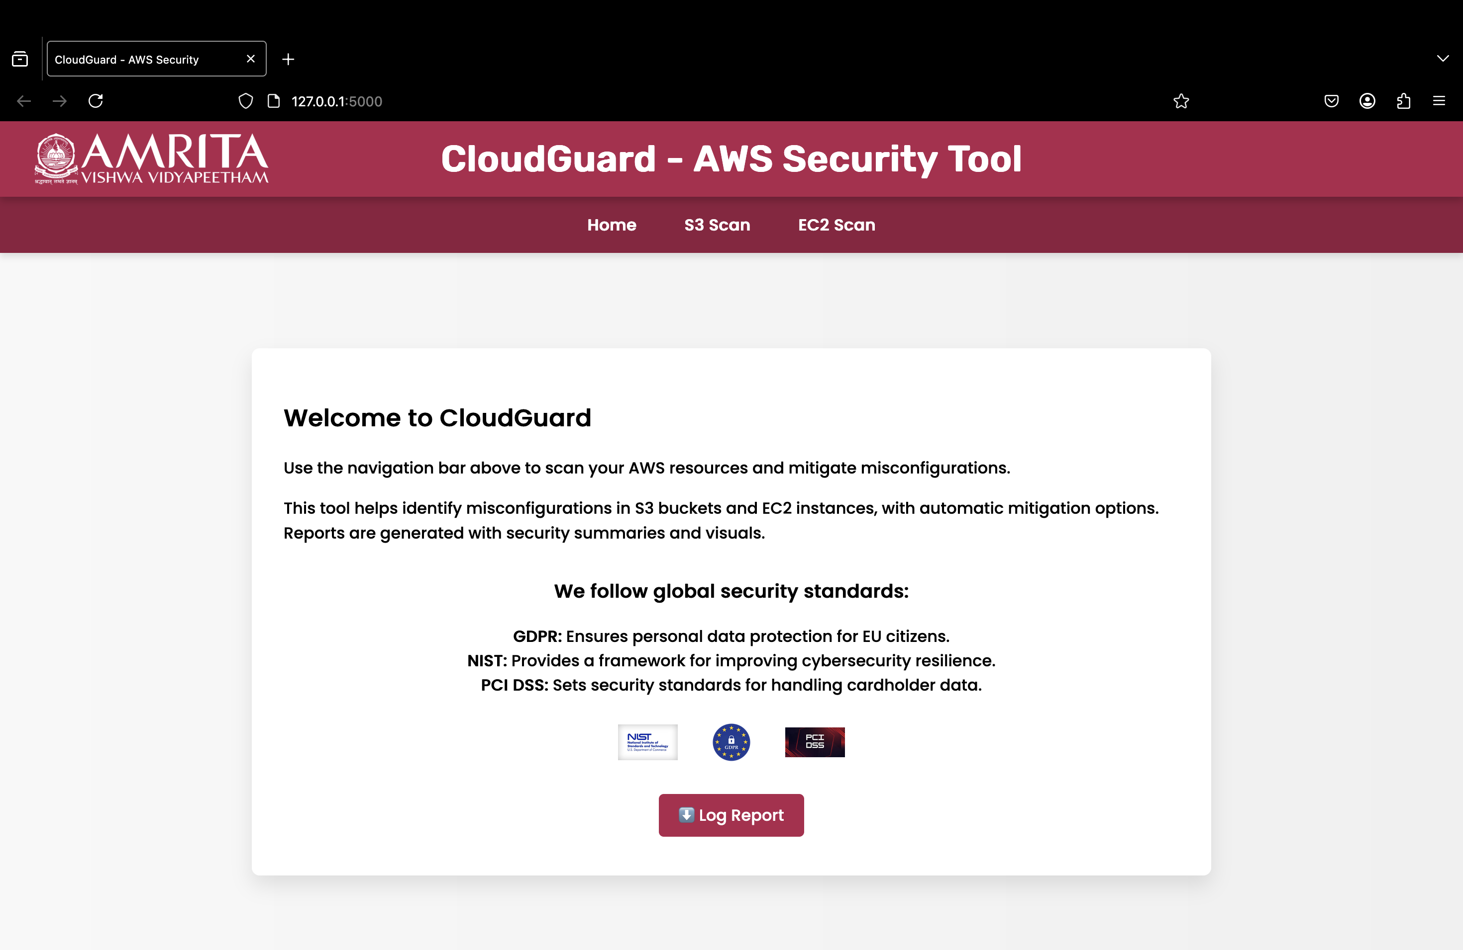
Home page
Introduction to CloudGuard: The page provides an overview of CloudGuard, an AWS security tool that scans AWS resources (S3 and EC2) to identify and mitigate misconfigurations.
Global Security Standards: It highlights the adherence to major global security standards, such as GDPR, NIST, and PCI DSS, ensuring that the tool helps in compliance with critical cybersecurity frameworks.
Log Report Feature: The page includes a button for users to log or download security reports, providing easy access to detailed scan results and mitigation steps.

Slide 8
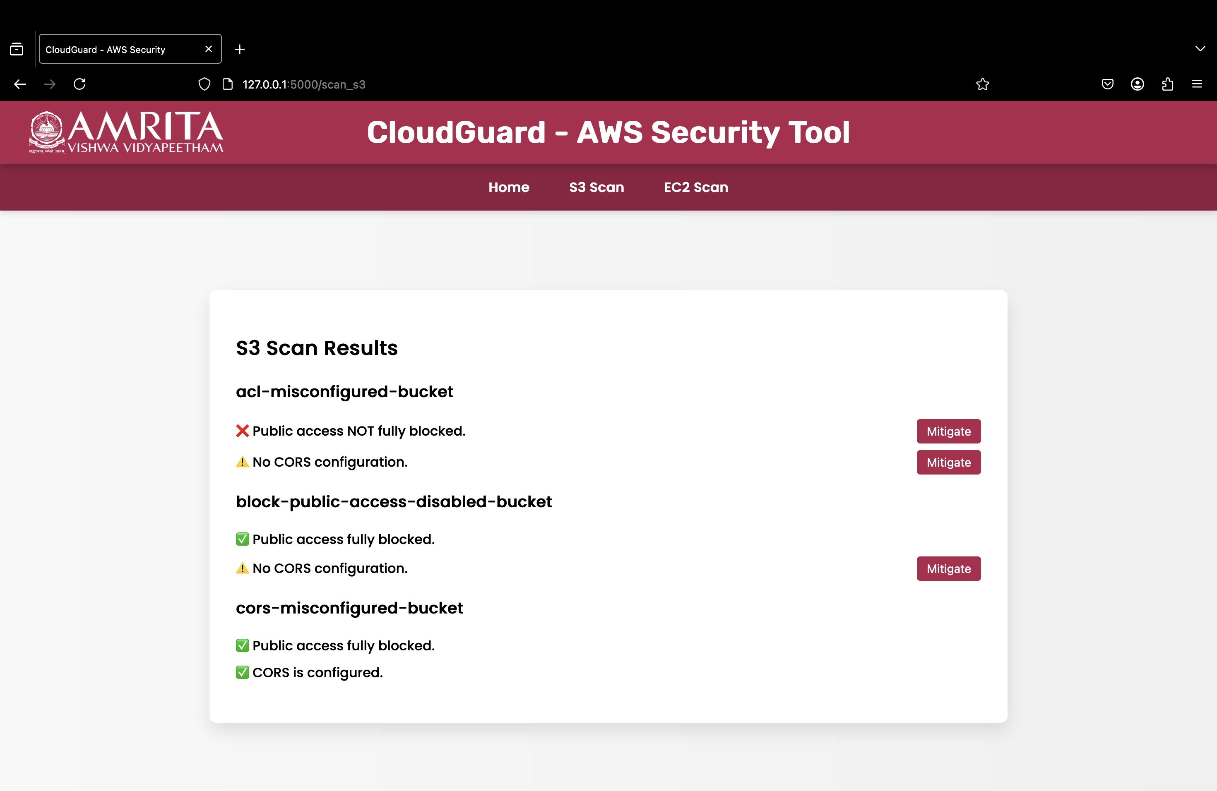
S3 SCAN PAGE
S3 Bucket Misconfiguration Scan Results: The page displays the results of the S3 bucket scan, showing which buckets are misconfigured based on public access and CORS settings.
Visual Indicators: The scan results use color-coded icons (✅, ❌, ⚠️) to highlight the configuration status of each bucket, making it easy to identify issues at a glance.
Mitigation Options: For each identified issue (e.g., public access not blocked or no CORS configuration), a "Mitigate" button is provided to enable users to take corrective actions directly from the page.

Slide 9
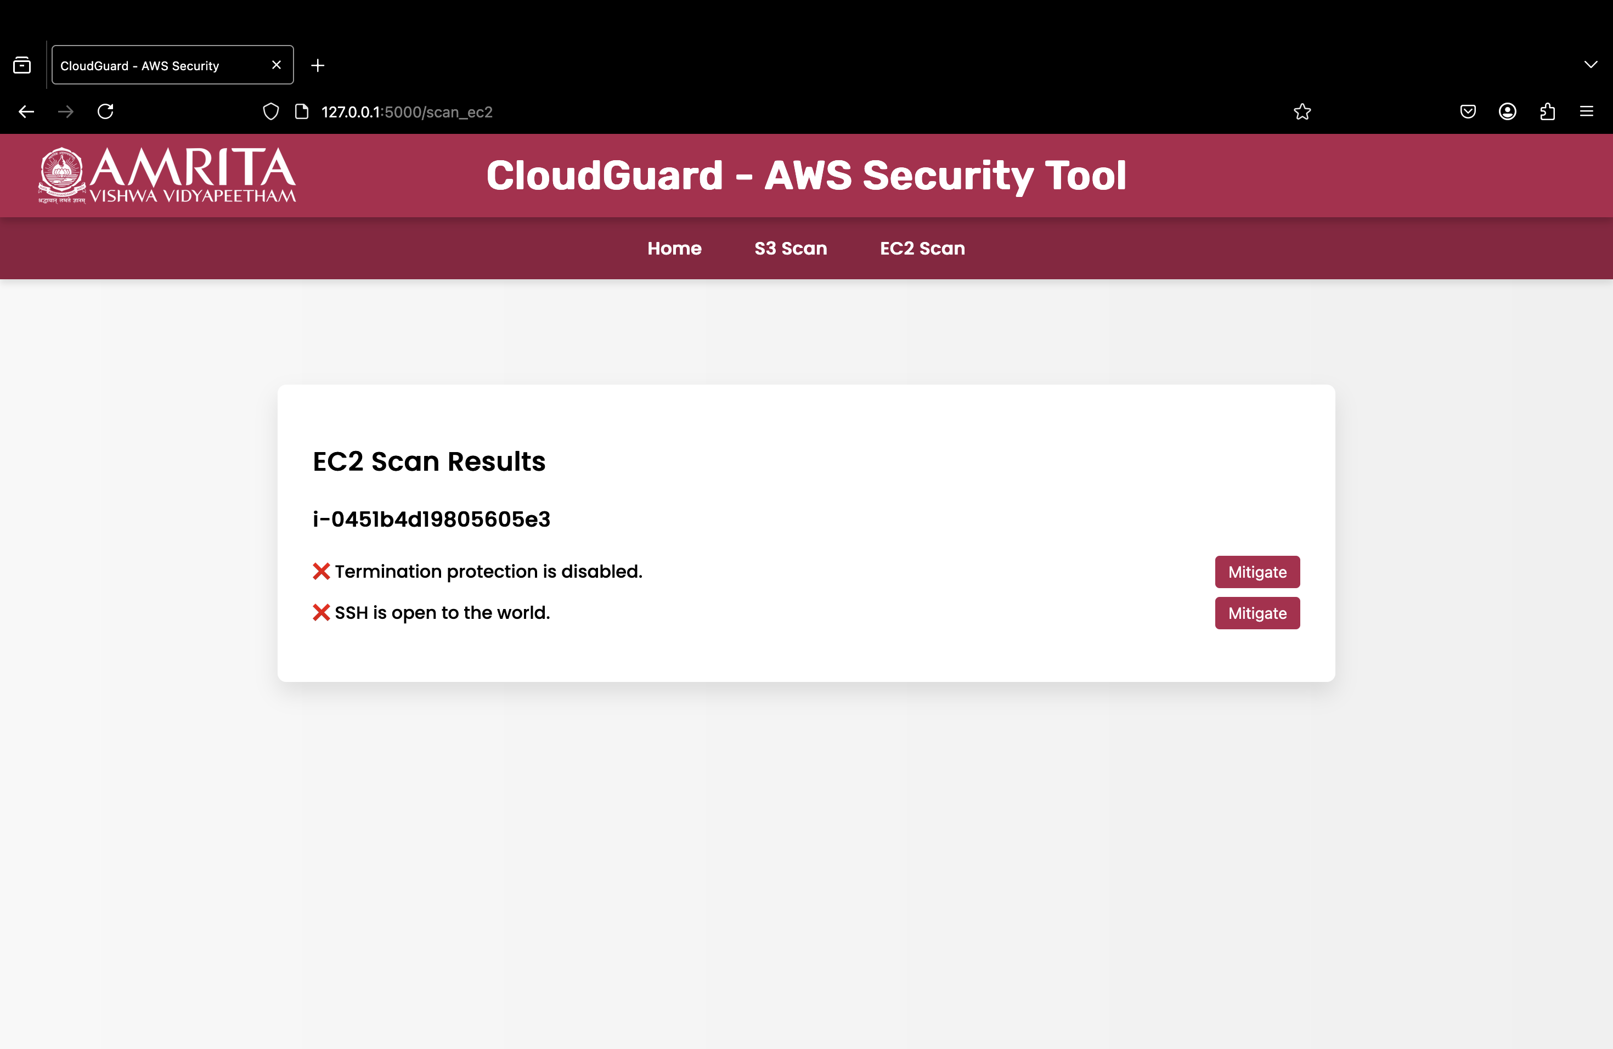
EC2 SCAN PAGE
EC2 Instance Misconfiguration Scan Results: The page displays the scan results for EC2 instances, specifically focusing on termination protection and SSH access.
Visual Indicators: Misconfigurations are highlighted using red icons (❌) for issues such as "Termination protection is disabled" and "SSH is open to the world," indicating a need for corrective action.
Mitigation Options: Each issue has a corresponding "Mitigate" button, allowing users to directly take action to resolve the identified security concerns.

